Slide 1
BOLEUM
LOGIC GAME PROJECT

Slide 2
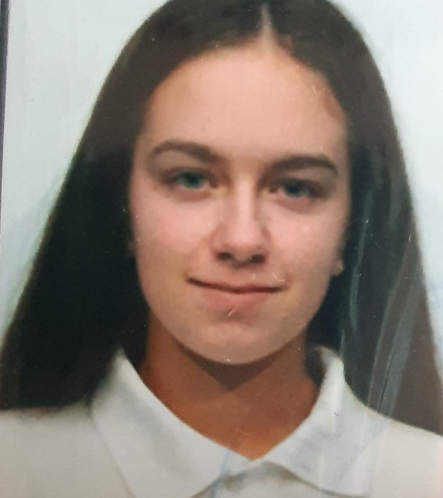
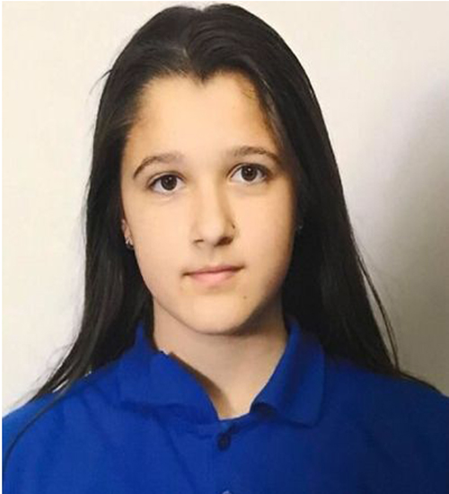
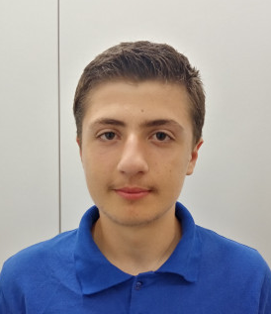
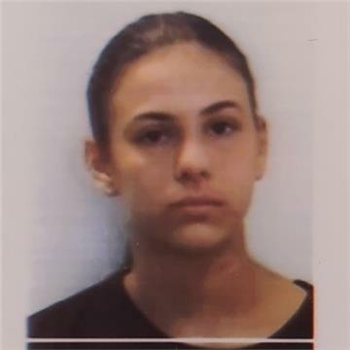
OUR TEAM
Valeria Yaneva
Scrum Trainer
Hakan Chandar
Back-end
Day 3
Zhanet Petkova
Back-end
Victoria Bolashikova
QA Engineer

Slide 3
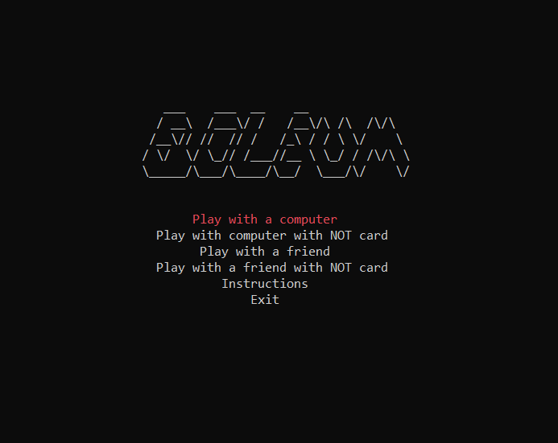
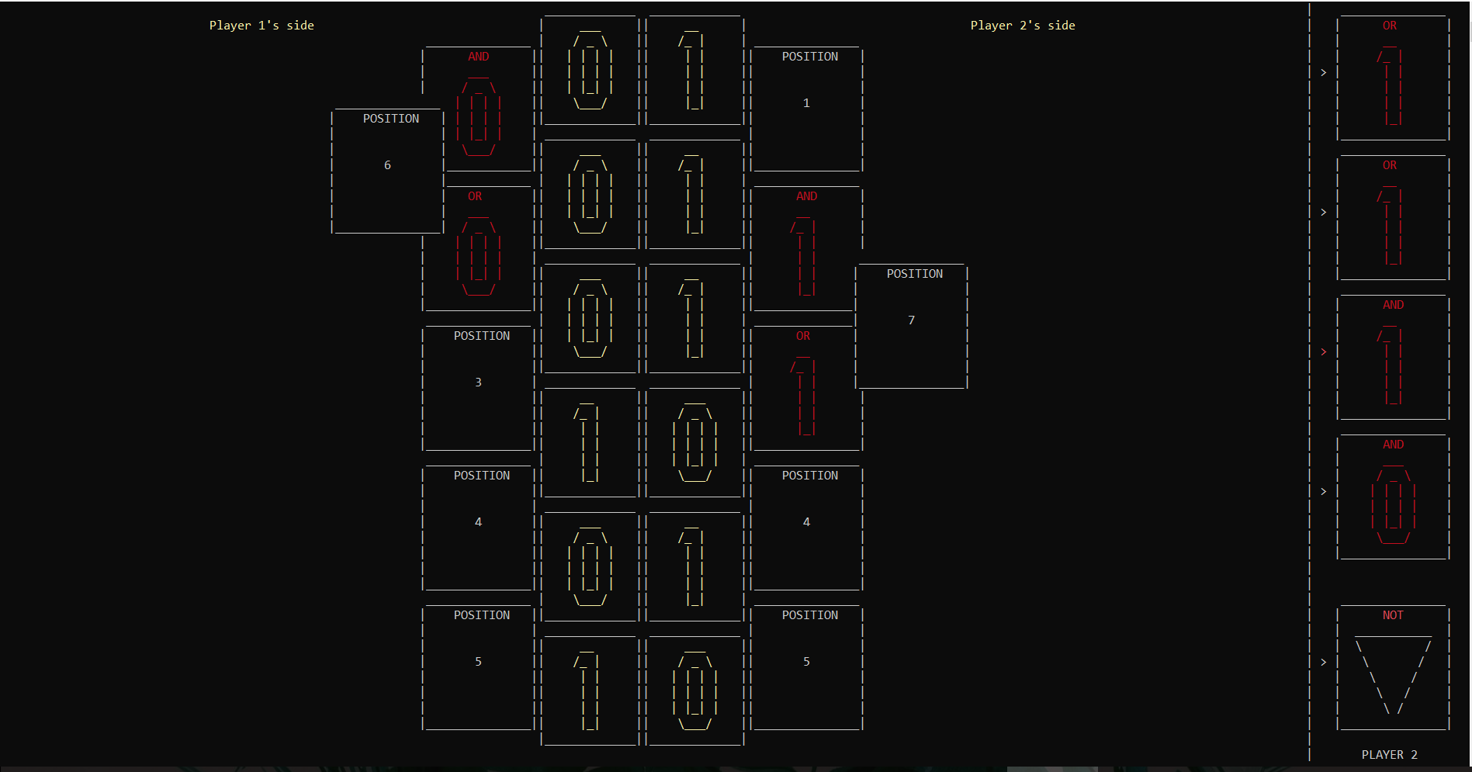
OUR IDEA

Slide 4
STAGES OF DEVELOPMENT
1.
3.
2.

Slide 5








USED PROGRAMS

Slide 6
LET’S JUMP TO THE PROJECT!

